Slide 1

Restriction enzymes
Restriction endonucleases

Slide 2
Restriction enzymes
Are enzymes that cut a DNA molecule at a particular place.
The enzyme "scans" a DNA molecule, looking for a particular sequence, usually of 4-6 nucleotides.
These sequences are palindromic in that the complimentary DNA strand has the same sequence only in the reverse direction, so both strands of DNA are cut at the same location. (GAATTA – ATTAAG)
Once it finds this recognition sequence, it stops and cuts the strands. This is known as enzyme digestion.

Slide 3
Restriction enzymes apparently evolved as a primitive immune system in bacteria.
The term "restriction" derives from the phenomenon in which bacterial viruses are restricted from replicating in certain strains of bacteria by enzymes that cleave the viral DNA, but leave the bacterial DNA untouched.
Methylation of DNA at the recognition sequence typically protects the microbe from cleaving its own DNA.

Slide 4
Nomenclature
Restriction enzymes are named based on the organism in which they were discovered.
For example, the enzyme Hin d III was isolated from Haemophilus influenzae, strain Rd.
The first three letters of the name are italicized because they abbreviate the genus and species names of the organism.

Slide 5
Nomenclature
The fourth letter (if present) refers to the bacterial strain designation.
The Roman numerals are used to identify specific enzymes from bacteria that contain multiple restriction enzymes.
Typically, the Roman numeral indicates the order in which restriction enzymes were discovered in a particular strain.

Slide 6
Nomenclature
BamH I: Bacillus amyloliquefaciens, strain H, enzyme I
Hind III: Haemophilus influenzae strain d, enzyme III
Sma I: Serratia marcesens, enzyme I
Kpn I: Klebsiella pneumonite, enzyme

Slide 7
Classification
There are three classes of restriction enzymes, labeled types I, II, and III.
Type I restriction systems
Consist of a single enzyme that performs both modification (methylation) and restriction activities.
These enzymes recognize specific DNA sequences, but cleave the DNA strand randomly, at least 1,000 base pairs (bp) away from the recognition site.

Slide 8
Classification
Type III restriction systems
Have separate enzymes for restriction and methylation, but these enzymes share a common subunit.
These enzymes recognize specific DNA sequences, but cleave DNA at random sequences approximately 25 bp from the recognition sequence.

Slide 9
Classification
Type II enzymes
Consist of single, separate proteins for restriction and modification.
Type II restriction enzymes cleave the DNA sequence at the same site at which they recognize it.
Neither type I nor type III restriction systems have found much application in recombinant DNA techniques.

Slide 10
Types of cuts of Restriction Enzymes
If they cut both strands at the center of the recognition sequence, it will generate "blunt ends" with no nucleotide overhangs.
If they cut both strands closer to one end of the recognition sequence, it will generates "sticky" or "cohesive" ends with nucleotide overhangs.

Slide 11
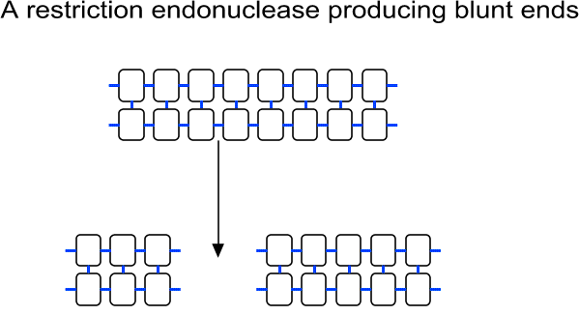
Types of cuts of Restriction Enzymes

Slide 12
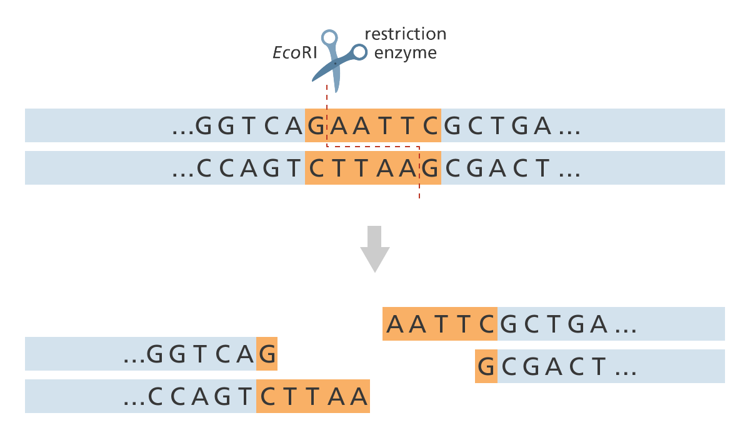
Types of cuts of Restriction Enzymes

Slide 13
Use of Restriction Enzymes in Biotechnology
DNA fragments or genomes map
Verify the identity of a specific DNA fragment
Identifying individuals or strains of a particular species
Restriction fragment length polymorphism (RFLP)
Pulsed field gel electrophoresis
Generation of recombinant DNA molecules

Slide 14
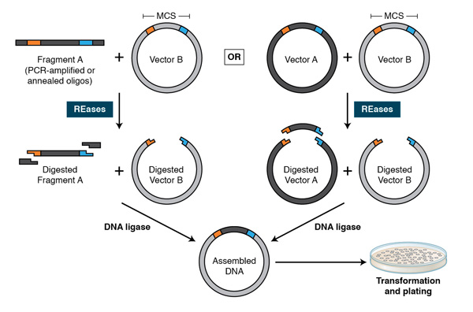

Slide 15
Unit Definition
One unit is the enzyme activity that completely cleaves 1 µg of substrate DNA suspended in
50 µl of the recommended reaction buffer in
60 minutes at the appropriate temperature under optimal assay conditions as stated for each restriction endonuclease.

Slide 16
Restriction enzyme digestion of DNA
Typical protocol
1µl 10x Buffer (A,B,C,D Salt conc, Mg conc, pH)
6µl H₂O
2µl DNA (kit extracted, salt interfere with enzyme, funny gel)
1µl Enzyme
Do not use more enzyme than 10% of the final reaction volume
the enzyme storage buffer contains antifreeze (glycerol) to allow it to survive at –20°C. The glycerol will inhibit the digestion if present in sufficient quantities.
Incubate at 37°C for one hour

Slide 17
Special conditions
Double digests
Digestion of DNA with two (or more) enzymes
Make sure to use the buffer that will be most compatible with all the enzymes.

Slide 18
Special conditions
A few enzymes require special conditions
Some require BSA (bovine serum albumin) added into the mixture.
Some require weak detergents (e.g. triton-X-100) to reduce surface tension.
Some require to be incubated at temperatures other than 37°C (e.g. 50°C)

Slide 19
Star activity
This is when the enzyme cuts at sites other than its cognate element.
e.g. EcoRI is supposed to only cut GAATTC but, under extreme conditions, it might possibly cut CAATTC also.

Slide 20
Problems with enzyme activity
Problems with enzyme activity can occur under the following conditions:
High glycerol concentration
Enzyme-to-DNA ratio is too high
pH is too high
Organic solvents, particularly ethanol, interfere with your DNA

Slide 21
Phosphorylation & Dephosphorylation
Digested DNA typically possesses a 5’ phosphate group that is required for ligation.
It is recommended to dephosphorylate (removal of the 5' phosphate) the linearized vector to prevent self-ligation & facilitate ligation of recombinant DNA molecules.
Dephosphorylation can be accomplished using any of a number of phosphatases, including Shrimp Alkaline Phosphatase (rSAP) , Calf Intestinal Alkaline Phosphatase (CIP)

Slide 22
Phosphorylation & Dephosphorylation
ligation requires the presence of a 5'-phosphate, the insert must be phosphorylated.
Blunt-ended PCR product normally lacks a 5'-phosphate, therefore it needs to be phosphorylated by treatment with T4 polynucleotide kinase
Digestion of DNA with a restriction enzyme will always produce a 5´ phosphate

Slide 23
DNA Ligation
The final step in the construction of a recombinant plasmid is connecting the insert DNA (gene or fragment of interest) into a compatibly digested vector backbone. This reaction, called ligation & is performed by the T4 DNA ligase enzyme
After ligation, the insert DNA is physically attached to the backbone and the complete plasmid can be transformed into bacterial cells for propagation.

Slide 24
Ligation Protocol
It is important to determine the amount of cut insert and vector to use for the ligation reaction.
The volume of vector DNA and insert DNA used in the ligation will vary depending on the size of each and their concentration.
for most standard cloning (where the insert is smaller than the vector) A 3 insert : 1 vector ratio will work just fine.

Slide 25
Ligation reaction optimization
http://www.insilico.uni-duesseldorf.de/Lig_Input.html
Just enter the concentration, lengths of the insert and vector, and what the ratio you want, and it will tell you exactly how much of each to use.

Slide 26
Ligation reaction
Since ATP can be damaged by repeated freeze-thaw cycles, it is advisable to make aliquots of the buffer.
The ligation reaction itself has two basic steps.
Firstly the DNA ends have to collide by chance and stay together long enough for the ligase to join them (low temperatures.)
The second step is the enzymatic reaction (T4 ligase).
Normally 1hr at 16°C is fine but since but overnight at 4°C can give even more efficiency.

Slide 27
Transformation
Introduction of exogenous genetic material (vector) into a bacterial cell. (uptake of DNA by bacterial cells)
The host cells must be specially prepared to take up the foreign DNA.
Selectable markers can be for antibiotic resistance, color changes, or any other characteristic which can distinguish transformed hosts from untransformed hosts.

Slide 28
Transformation
Most types of cells cannot take up DNA efficiently unless they have been exposed to special chemical or electrical treatments to make them competent .
The standard method for making the bacteria permeable to DNA involves treatment with calcium ions (CaCl₂ ).
Brief exposure of cells to an electric field also allows the bacteria to take up DNA and this process is called as electroporation

Slide 29
Transformation
ln CaCl₂ method, the competency can be obtained by creating pores in bacterial cells by suspending them in a solution containing high concentration of calcium.
The plasmid DNA is mixed with chilled cells and incubated on ice to allow the plasmid to come into close contact with the cells.
The plasmid-cell mixture then is briefly heated to 42°C, allowing the DNA to enter the cell through the disrupted membrane
The heated mixture is then placed back on ice to retain the plasmids inside the bacteria

Slide 30
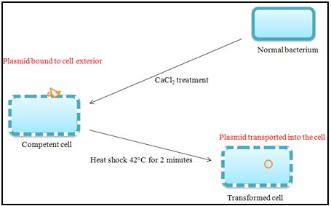

Slide 31
Transformation
For electroporation, the competent cells also sit on ice with the plasmid DNA.
However, the plasmid-cell mixture is exposed to an electrical current, opening pores in the cell membrane so that the plasmid can enter the cell.
Both methods allow efficient recovery of transformed cells using antibiotic selection for the plasmid of interest.

Slide 32
Thank You
For your attention
Dr. Hatem Toughan
Fish Medicine
Faculty of Veterinary Medicine
Assiut University

