Slide 1
Gene Expression
Ameer Effat M. Elfarash
Dept. of Genetics
Fac. of Agriculture, Assiut Univ.
aelfarash@aun.edu.eg

Slide 2
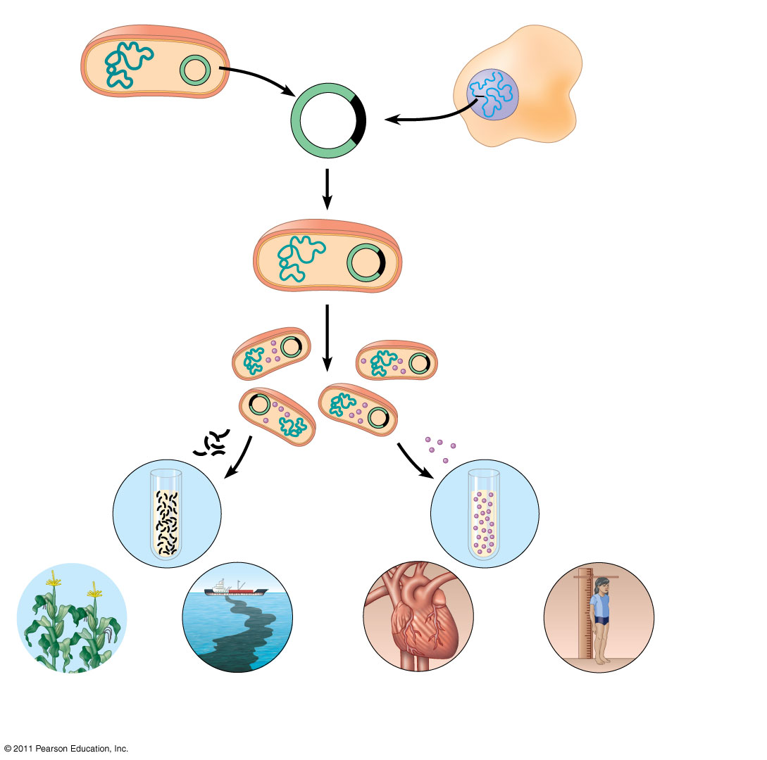
Bacterium
1
Gene inserted into
plasmid
Cell containing gene
of interest
Bacterial
chromosome
Plasmid
Gene of
interest
Recombinant
DNA (plasmid)
DNA of
chromosome
(“foreign” DNA)
2
Plasmid put into
bacterial cell
Recombinant
bacterium
3
Host cell grown in culture to
form a clone of cells containing
the “cloned” gene of interest
Gene of
interest
Protein expressed from
gene of interest
Copies of gene
Protein harvested
4
Basic research
and various
applications
Basic
research
on gene
Basic
research
on protein
Gene for pest
resistance inserted
into plants
Gene used to alter
bacteria for cleaning
up toxic waste
Protein dissolves
blood clots in heart
attack therapy
Human growth
hormone treats
stunted growth

Slide 3
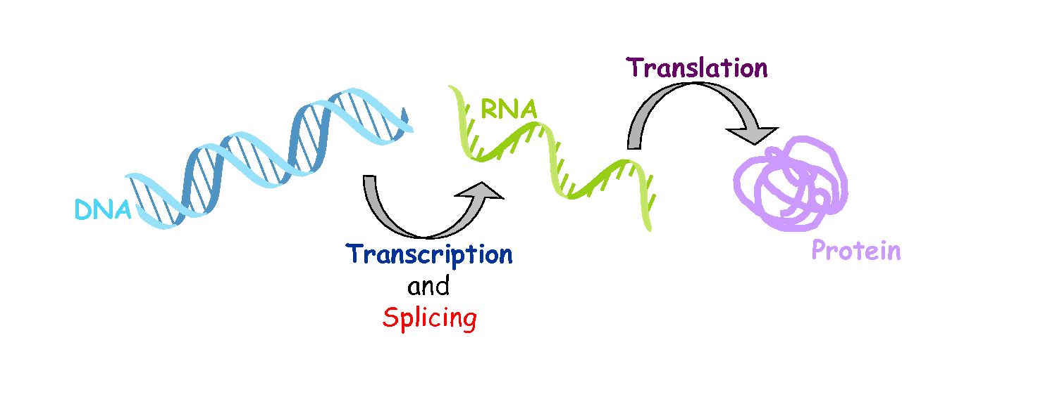

Slide 4
Transcription

Slide 5
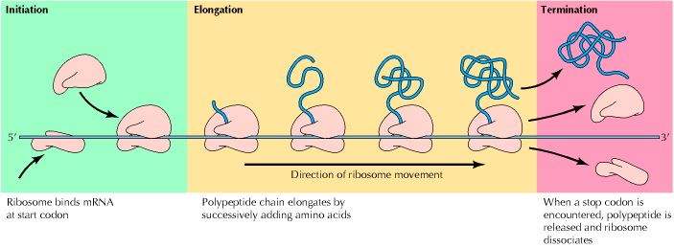
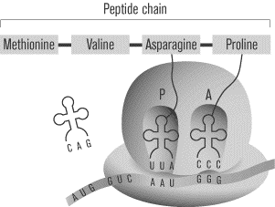
Translation

Slide 6
The Regulation of Gene Expression

Slide 7
Lac Operon
The Regulation of Gene Expression
Animation

Slide 8
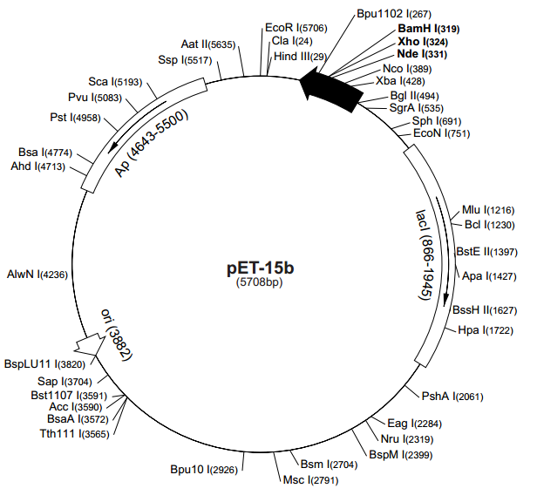
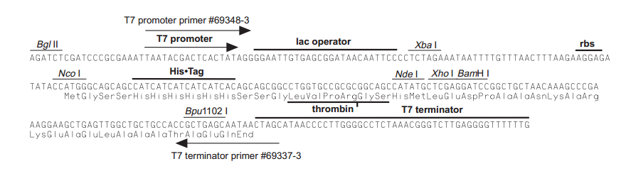

Slide 9
Protein Expression
Phase 3
OD₆₀₀
Phase 2
Exponential
IPTG induction
Phase 1
Time
Liquid LB medium
with bacteria in it

Slide 10
Bacterial Growth
Bacterial DNA
Plasmid DNA
Bacterial protein
Target protein
Pellet

Slide 11
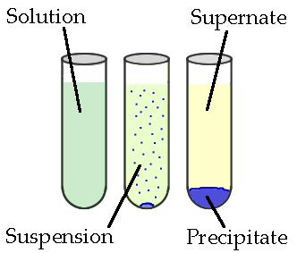
Lysis
Pellet is resuspended in the lysis buffer containing, and sonicated to further liberate the protein
Spin down the denaturing lysis buffer, cell wall and debris will pellet at the bottom and our protein is in the soluble supernatant.
Soluble proteins
Sonication.
Centrifuge.
Sonication.
Centrifuge.

Slide 12
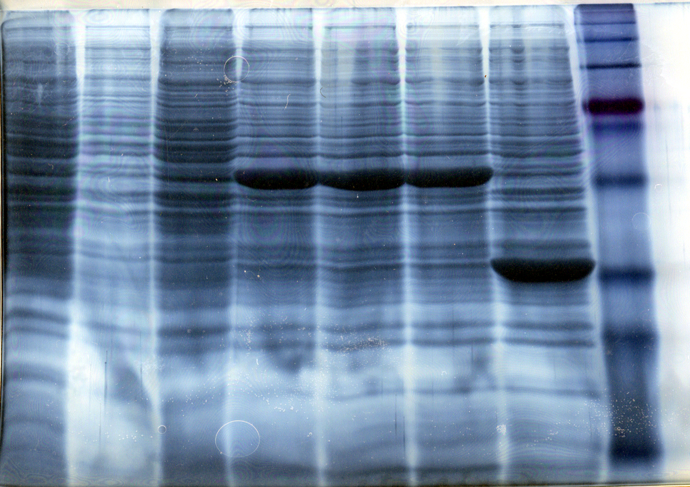
Expression of protein in E. coli
Uninduced
Induced Samples
We want to work with pure proteins. How do we purify it from all the other E. coli proteins?

Slide 13
Why purify a protein?
To study its function, Activity
For industrial or therapeutic applications
Study protein regulation and protein interactions
Produce Antibodies
Perform structural analysis by X-Ray and Crystallography
HOW to purify a protein?

Slide 14
Affinity chromatography (AC)
What is AC?
AC is a technique enabling purification of a biomolecule with respect to biological function or individual chemical structure.
AC is designed to purify a particular molecule from a mixed sample.

Slide 15
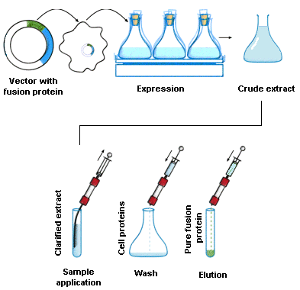
Affinity chromatography applied to recombinant proteins

Slide 16
Affinity Chromatography
His
His
His
His
His
His
Ni
rbs
Agarose

Slide 17
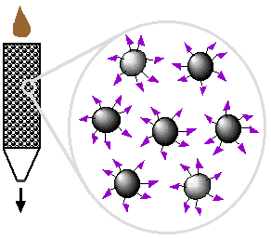
Affinity Ligand
Matrix

Slide 18
Step 1. Loading affinity column.

Slide 19
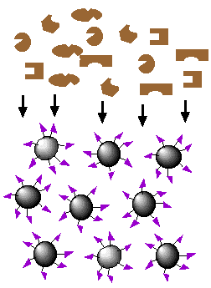
Step 2. Proteins sieve through matrix of affinity beads.

Slide 20
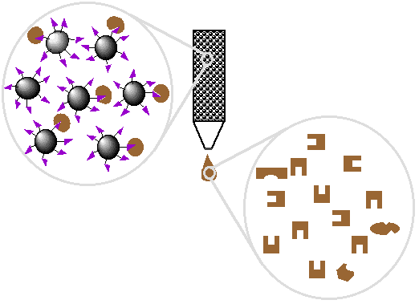
Step 5. Wash off proteins that bind loosely.

Slide 21
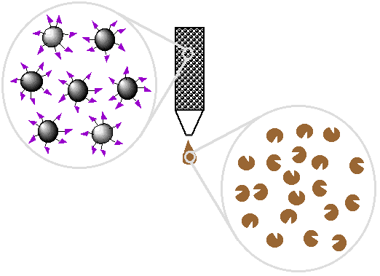
Step 6. Elute proteins that bind tightly to ligand and collect purified protein of interest.

Slide 22
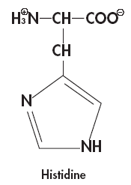
Elution with imidazole
Why imidazole?
The imidazole ring is part of the structure of histidine
Ni
2+
Ni
2+

Slide 23
Affinity chromatography applied to recombinant proteins

Slide 24
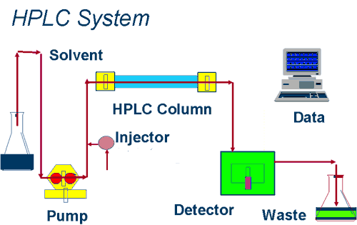
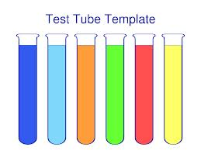
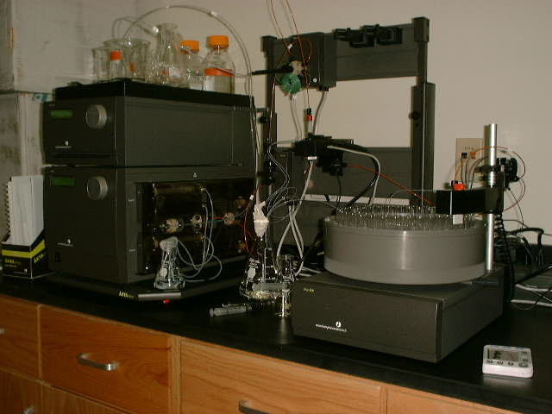
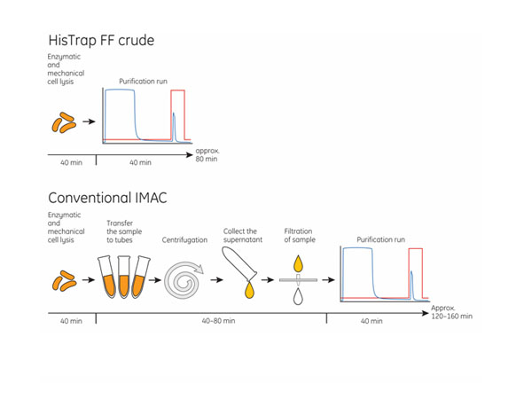
IMAC System

Slide 25
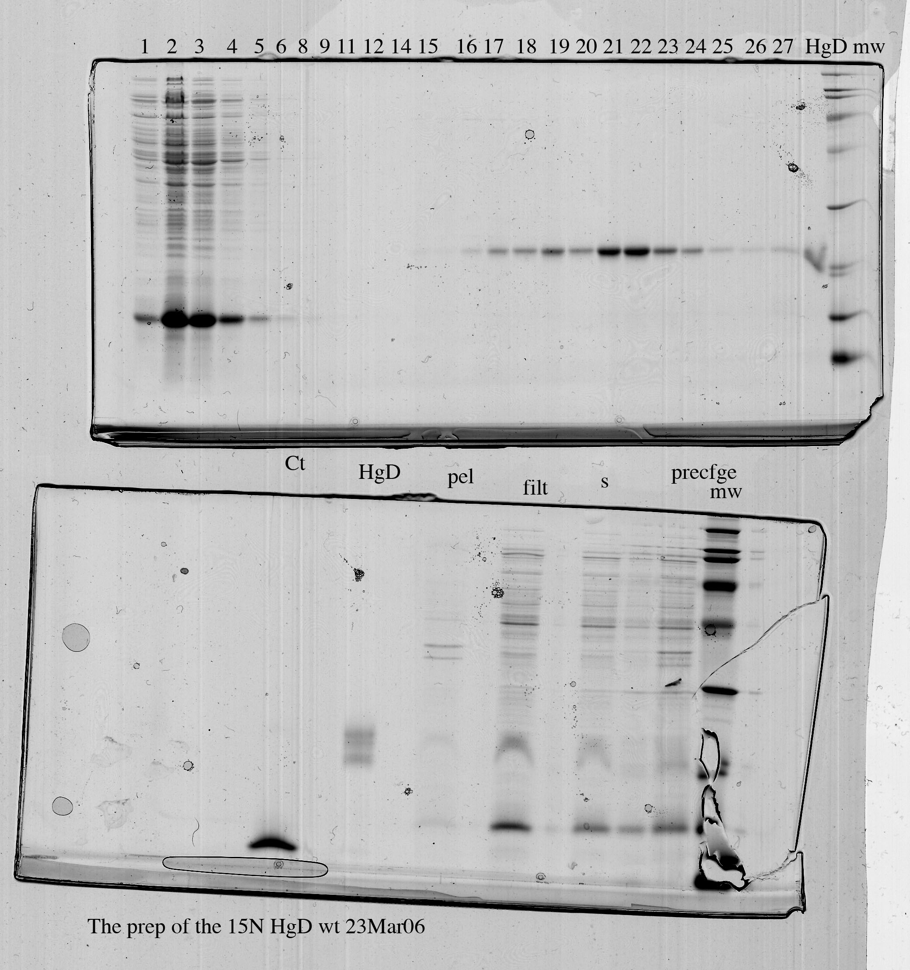
Purity test

Slide 26
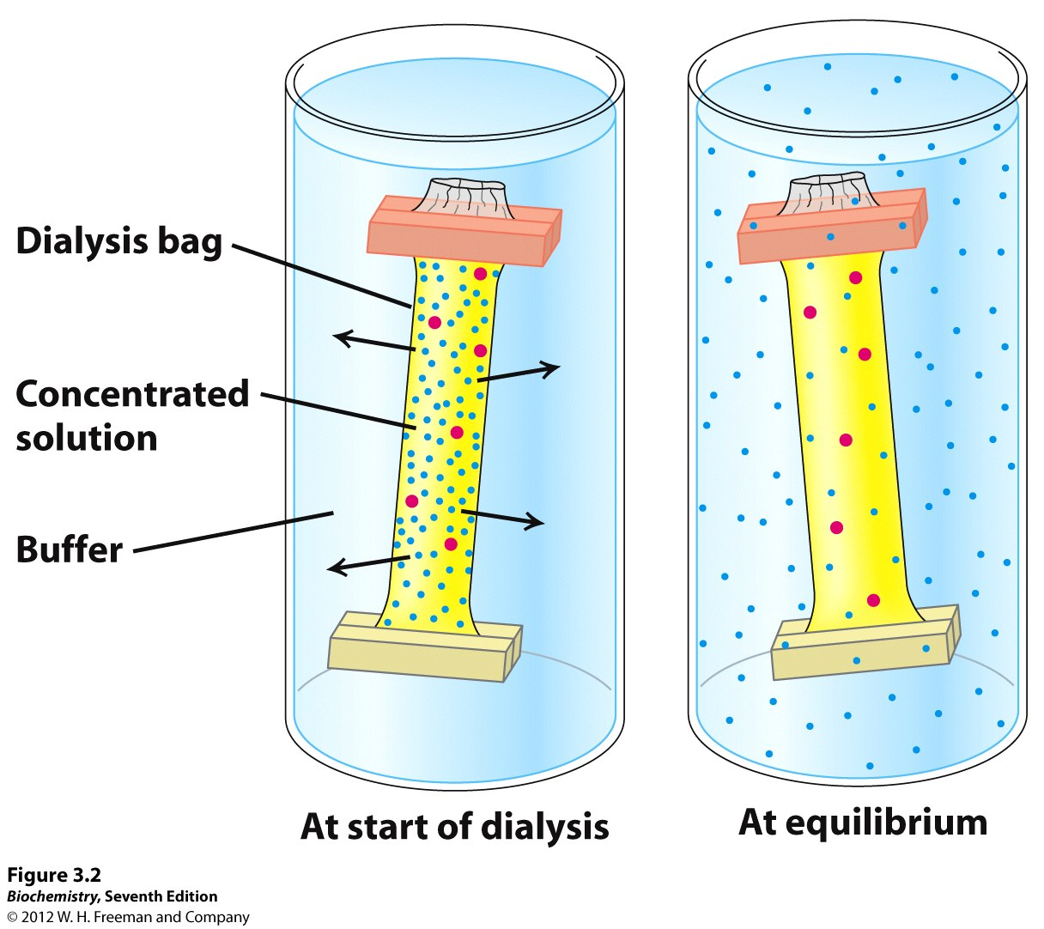
Protein dialysis

Slide 27
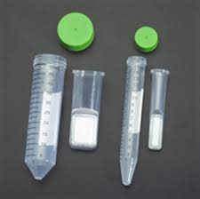
Protein Concentrators

Slide 28
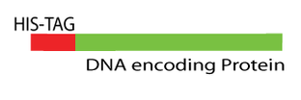
Cleavage of His tag
His tag is not part of the protein. It needs to be removed in order to perform structural and biophysical studies on the protein.
- Thrombin is used to remove the His tag.

Slide 29
Examples of tags and ligands
His-tag
FLAGTM peptide
Strep-tag
GST tag
Maltose binding protein fusion
Calmodulin binding protein fusion
Transition metal ion
Monoclonal antibody
Biotin
Glutathione
Amylose
Ca²⁺

Slide 30
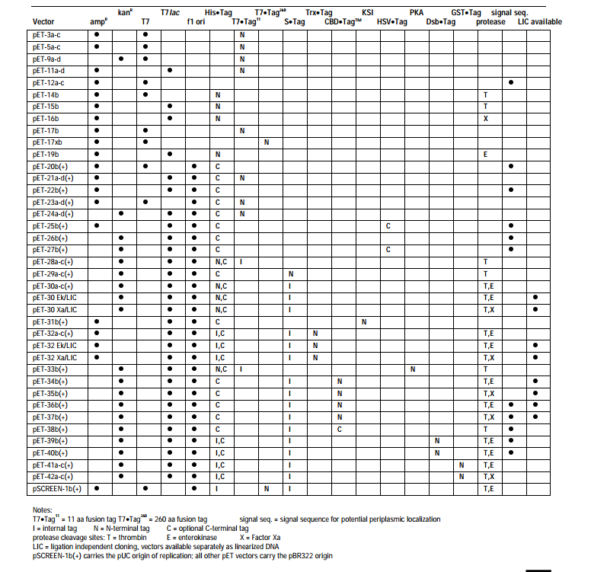

Slide 31


