Slide 1
Gene Expression
Ameer Effat M. Elfarash
Dept. of Genetics
Fac. of Agriculture, Assiut Univ.
aelfarash@aun.edu.eg

Slide 2
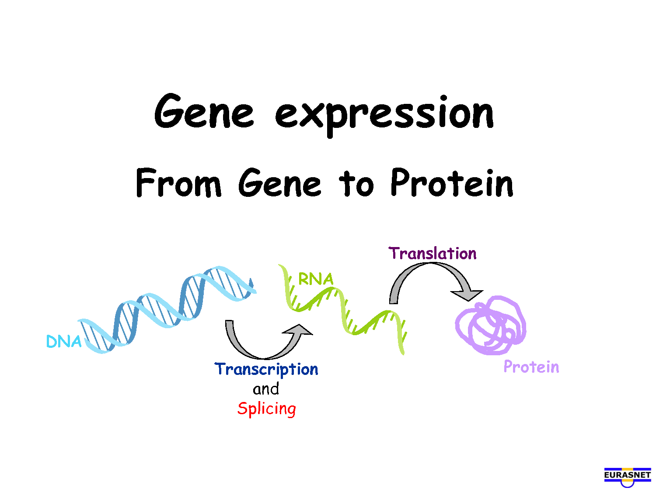

Slide 4
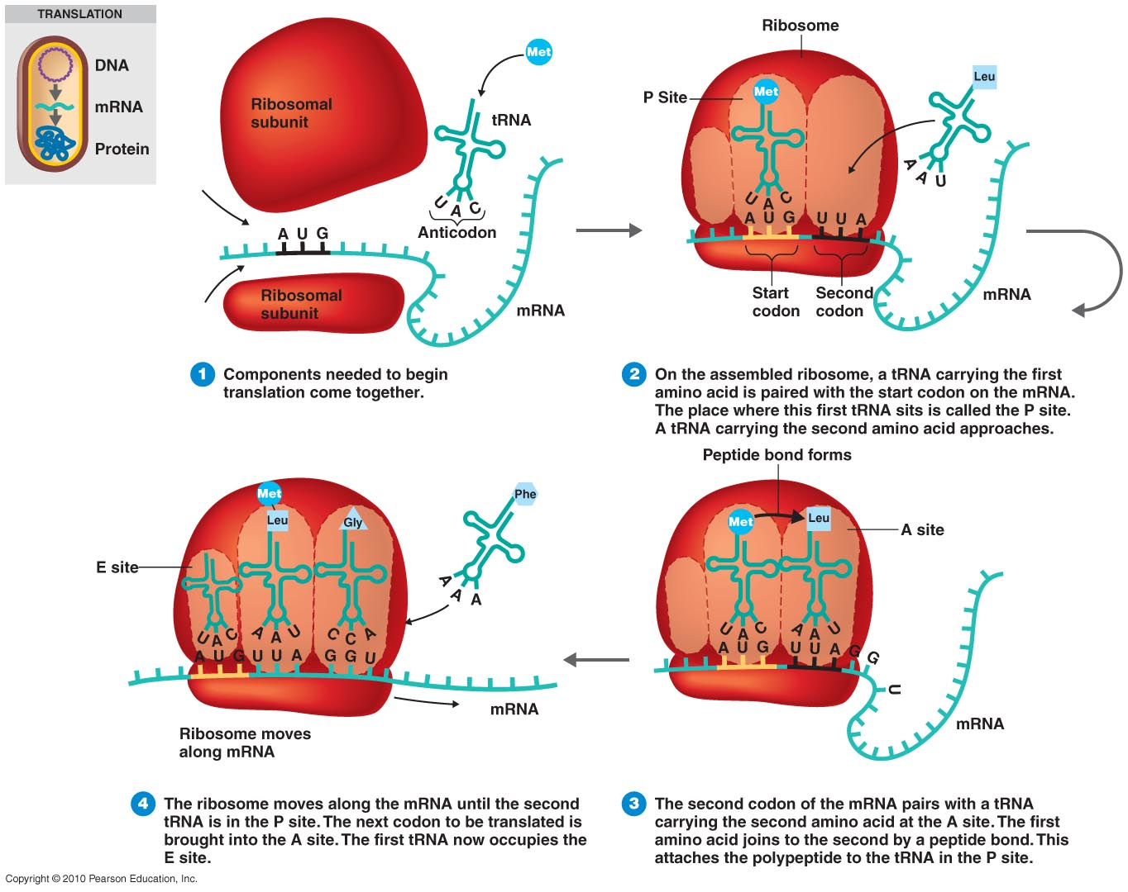
Initiation

Slide 5
The Process of Translation

Slide 6
The Process of Translation

Slide 7
The Process of Translation

Slide 8
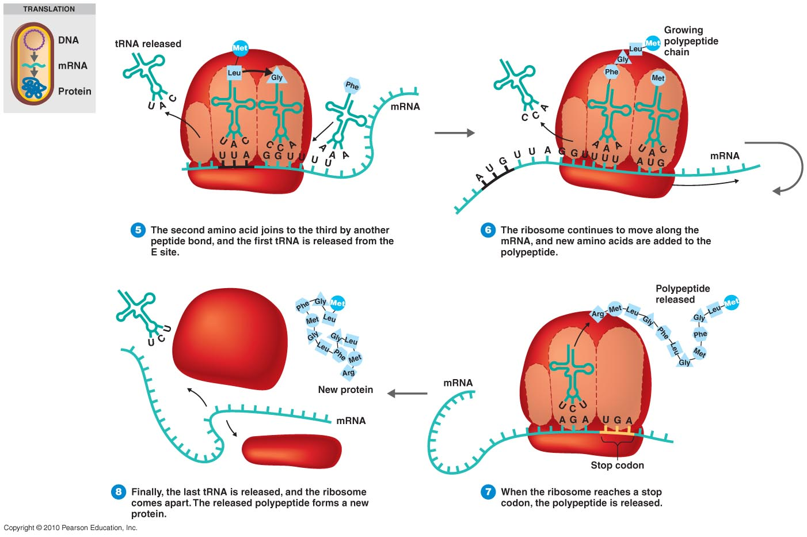
The Process of Translation

Slide 9
The Process of Translation

Slide 10
The Process of Translation

Slide 11
The Process of Translation

Slide 12
The Regulation of Gene Expression
Constitutive genes are expressed at a fixed rate
Other genes are expressed only as needed
Metabolism
Response to environmental stress
Cell division

Slide 13
Lac Operon
Animation

Slide 14
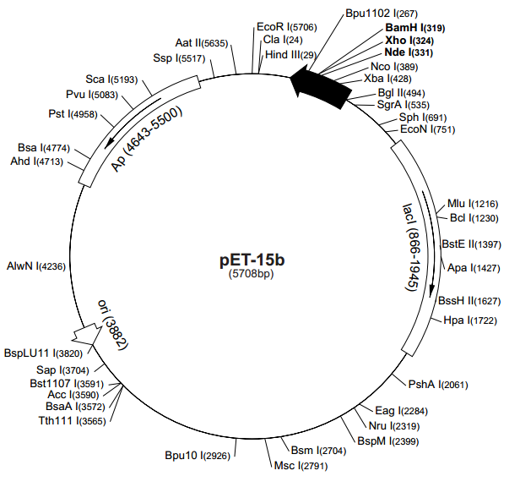
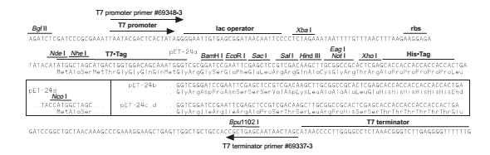

Slide 15
Protein Expression
Phase 3
OD₆₀₀
Phase 2
Exponential
IPTG induction
Phase 1
Time
Liquid LB medium
with bacteria in it

Slide 16
Bacterial Growth
Bacterial DNA
Plasmid DNA
Bacterial protein
Target protein
Pellet

Slide 17
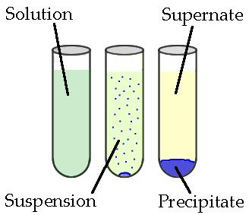
Lysis
Pellet is resuspended in the lysis buffer containing, and sonicated to further liberate the protein
Spin down the denaturing lysis buffer, cell wall and debris will pellet at the bottom and our protein is in the soluble supernatant.
Soluble proteins
Sonication.
Centrifuge.
Sonication.
Centrifuge.

Slide 18
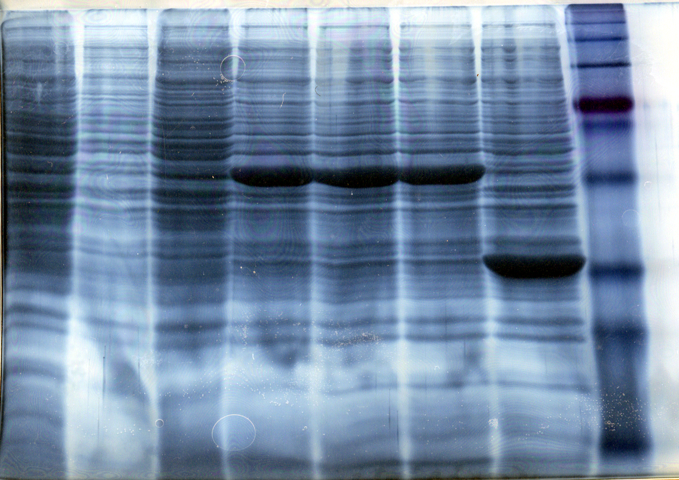
Expression of protein in E. coli
Uninduced
Induced Samples
We want to work with pure proteins. How do we purify it from all the other E. coli proteins?

Slide 19
Why purify a protein?
To study its function, Activity
For industrial or therapeutic applications
Study protein regulation and protein interactions
Produce Antibodies
Perform structural analysis by X-Ray and Crystallography
HOW to purify a protein?

Slide 20
Affinity chromatography (AC) What is AC?
AC is a technique enabling purification of a biomolecule with respect to biological function or individual chemical structure.
AC is designed to purify a particular molecule from a mixed sample.

Slide 21
Affinity Chromatography
His
His
His
His
His
His
Ni
Agarose

Slide 22
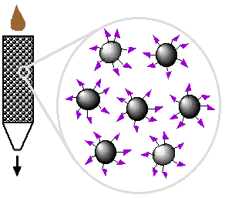
Affinity Ligand
Matrix

Slide 23
Step 1. Loading affinity column.

Slide 24
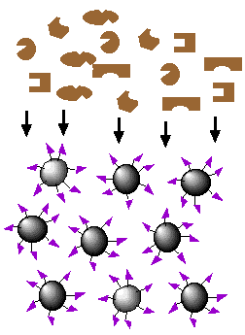
Step 2. Proteins sieve through matrix of affinity beads.

Slide 25
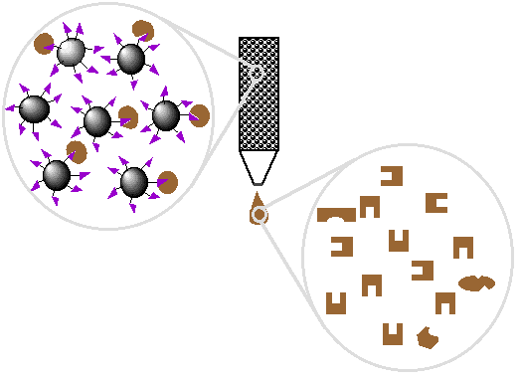
Step 5. Wash off proteins that bind loosely.

Slide 26
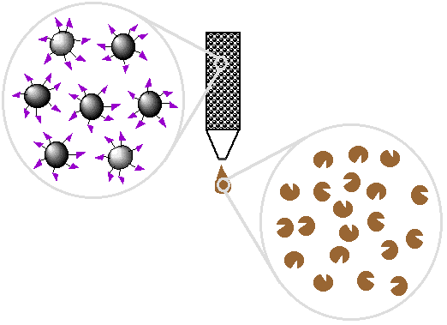
Step 6. Elute proteins that bind tightly to ligand and collect purified protein of interest.

Slide 27
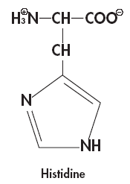
Elution with imidazole Why imidazole?
The imidazole ring is part of the structure of histidine
Ni
2+
Ni
2+

Slide 28
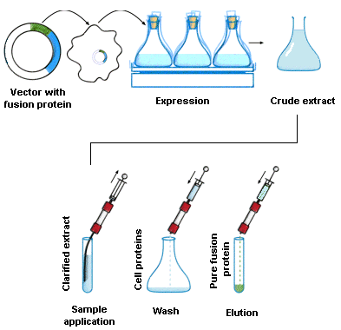
Affinity chromatography applied to recombinant proteins

Slide 29
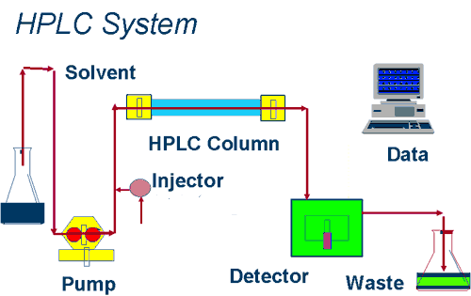
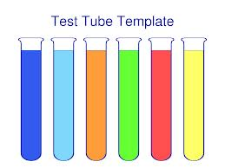
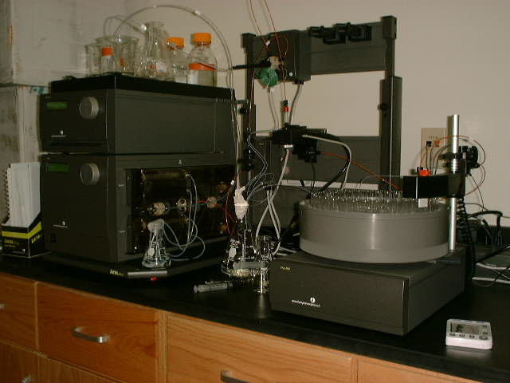
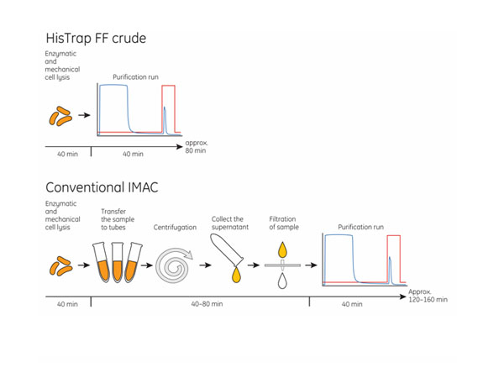
IMAC System

Slide 30
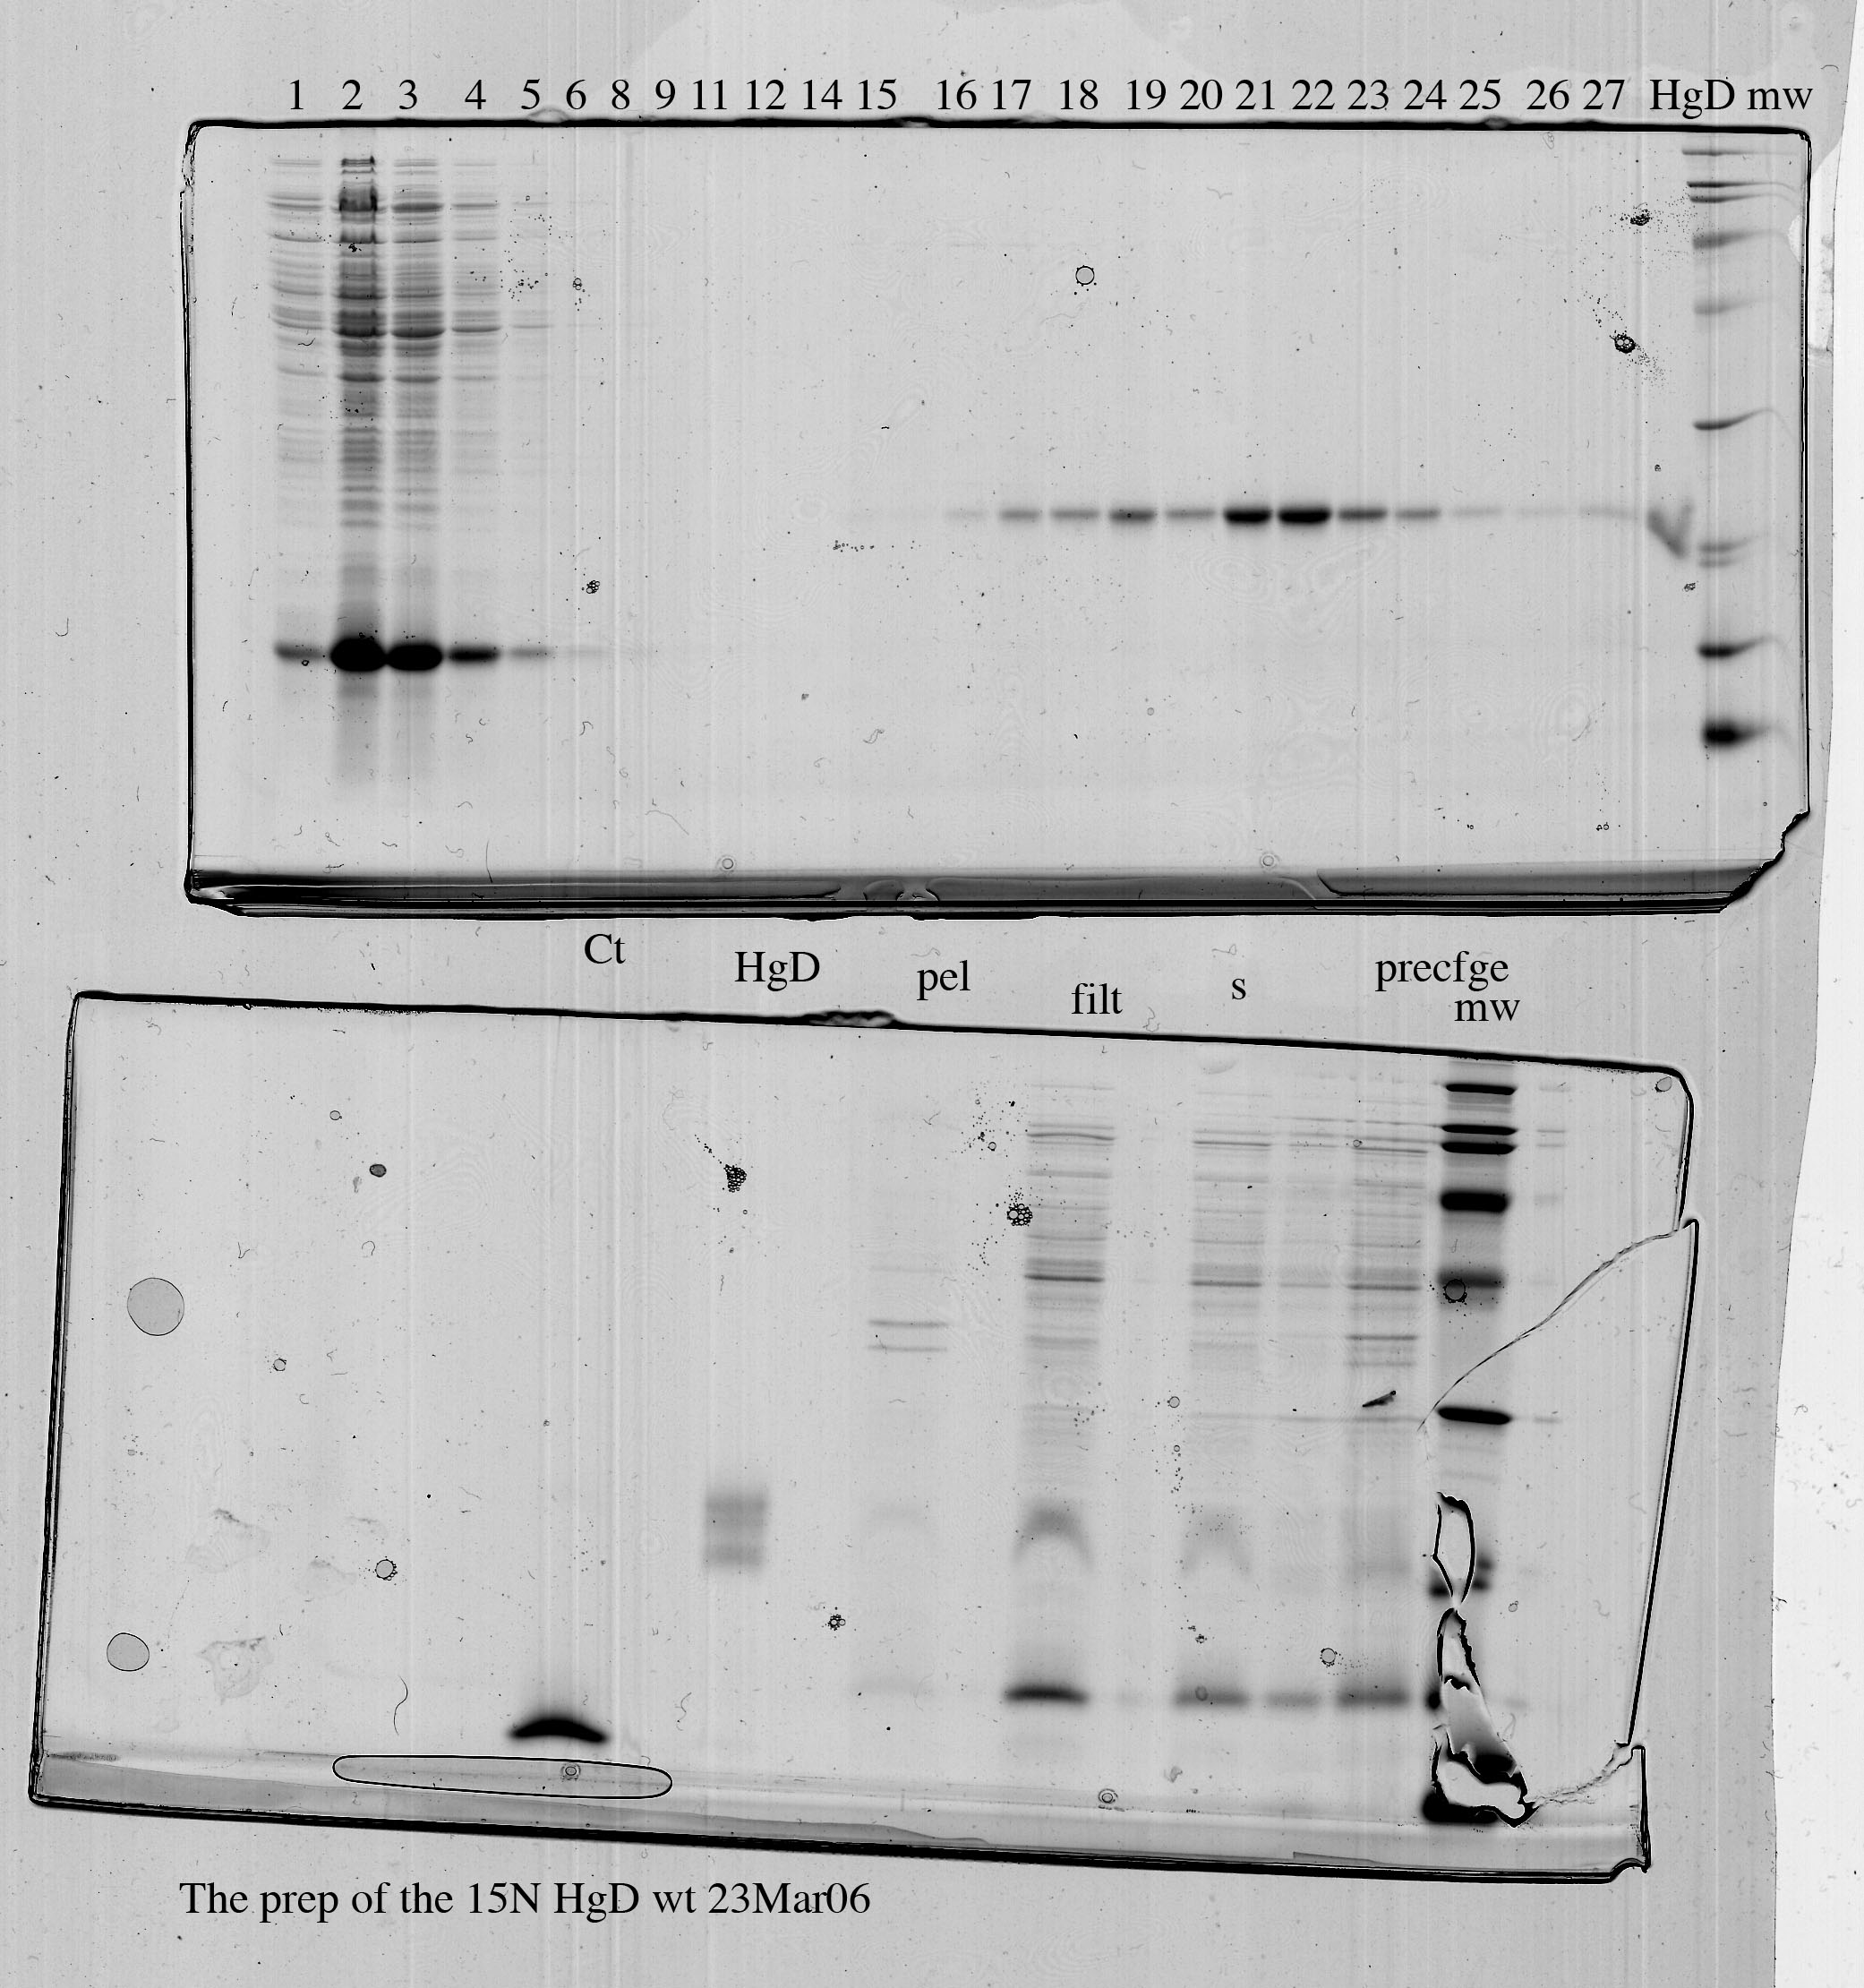
Purity test
SDS-PAGE

Slide 31
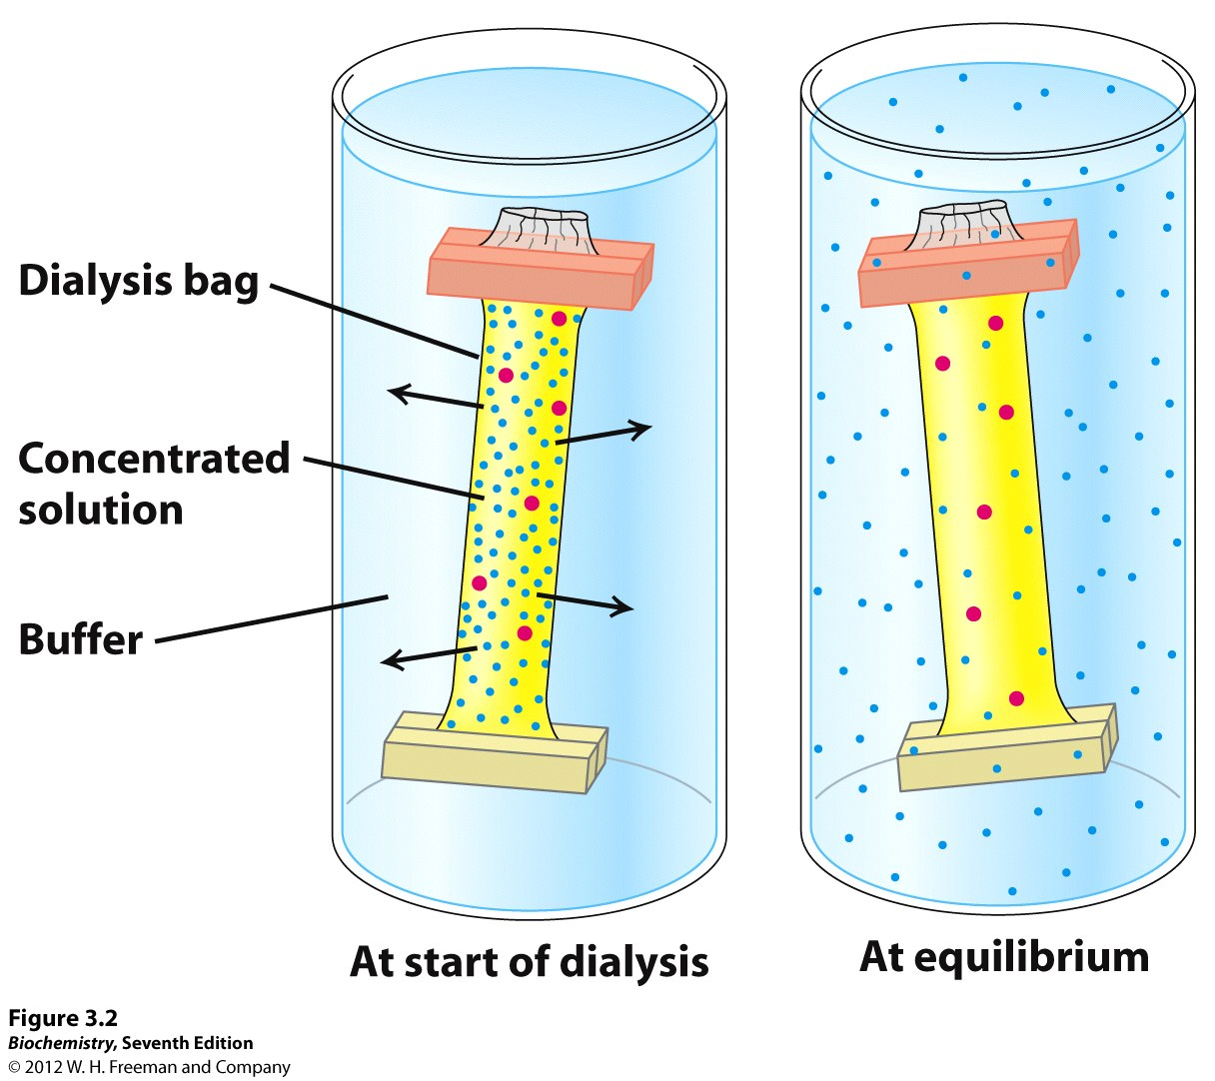
Protein dialysis

Slide 32
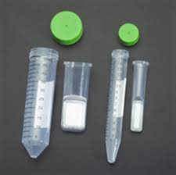
Protein Concentrators

Slide 33
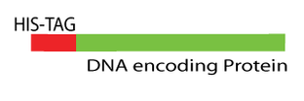
Cleavage of His tag
His tag is not part of the protein. It needs to be removed in order to perform structural and biophysical studies on the protein.
- Thrombin is used to remove the His tag.
Thrombine:
It is a protease, an enzyme that cleaves of the protein
at a specific recognition sequence.
When Thrombine is added in the solution it recognizes
the cutting site, located just after the His tag and cleaves
the his tag off.

Slide 34
Examples of tags and ligands
His-tag
FLAGTM peptide
Strep-tag
GST tag
Maltose binding protein fusion
Calmodulin binding protein fusion
Transition metal ion
Monoclonal antibody
Biotin
Glutathione
Amylose
Ca²⁺

Slide 35
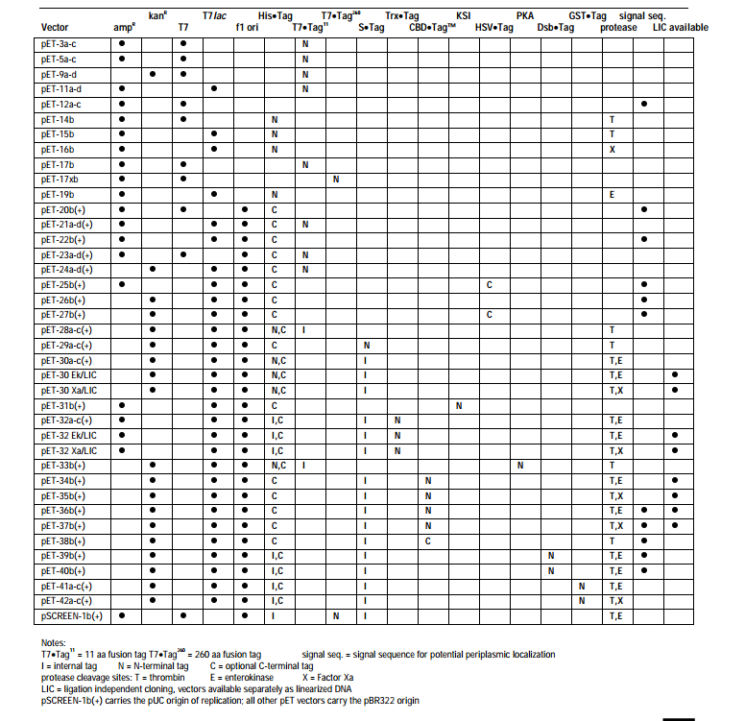

Slide 36


