Slide 1
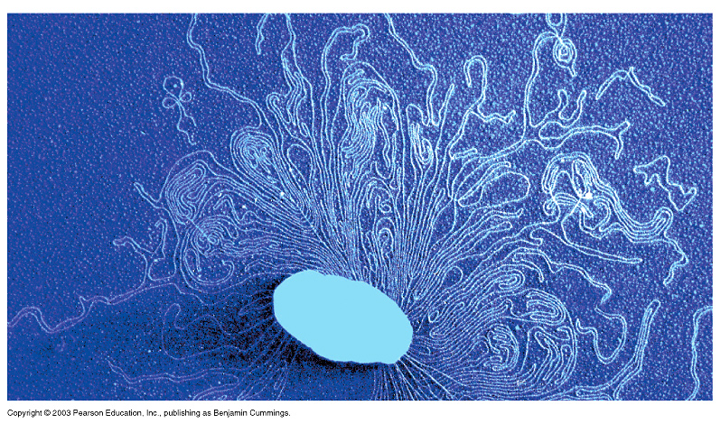
Cloning Vectors
Ameer Effat M. Elfarash
Dept. of Genetics
Fac. of Agriculture, Assiut Univ.
aelfarash@aun.edu.eg

Slide 2
CLONING VECTORS
Cloning vectors are DNA molecules that are used to "transport" cloned sequences between biological hosts and the test tube.
Most vectors are genetically engineered.
A vector is used to amplify a single molecule of DNA into many copes.
Cloning vectors share four common properties:
1. Ability to replicate.
2. Contain a genetic marker for selection.
3. Unique restriction sites to facilitate cloning of insert DNA.
4. Minimum amount of nonessential DNA to optimize cloning.

Slide 3
Types of vectors
Different types of cloning vectors are used for different types of cloning experiments.
The vector is chosen according to the size and type of DNA to be cloned
Maximum insert size
(kilobases or kb [1000bp])
Bacterial plasmid
bacteriophage
Cosmids
yeast artificial chromosome
6-12
25
35
200-1000

Slide 4
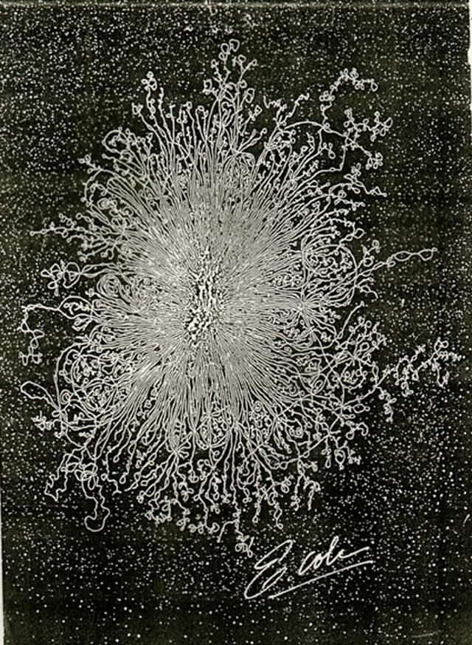
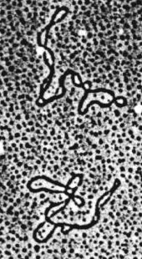

Bacterial plasmids
Most bacterial DNA is on a single large chromosome, but some DNA is in a small circle called a plasmid.

Slide 5
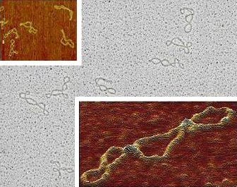
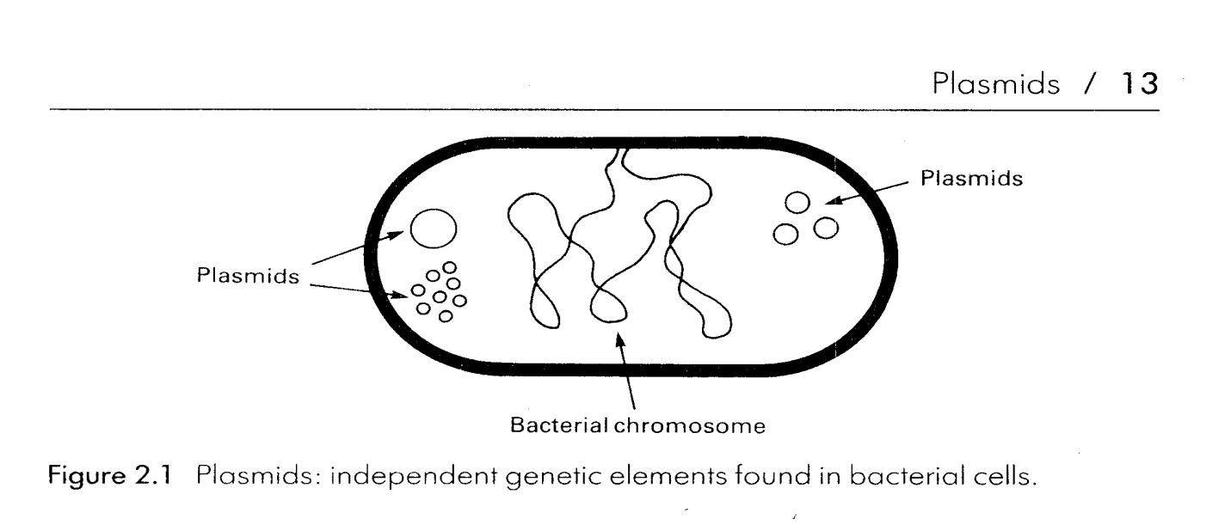
Bacterial Plasmids in Nature
Occur naturally in bacteria and usually carry genes that are useful but not essential to survival
There can be as many as several hundred copies of a single plasmid in each bacteria.
They can replicate independently of the host cell.

Slide 6
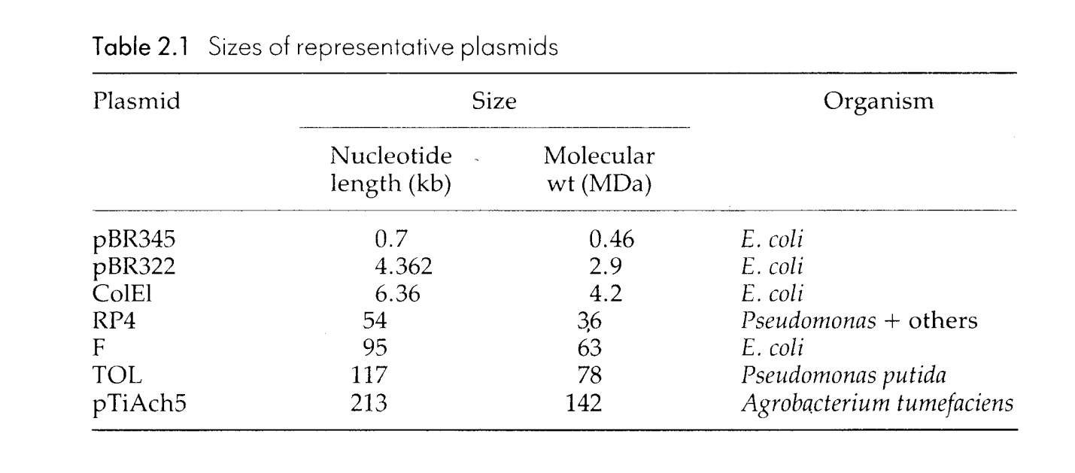
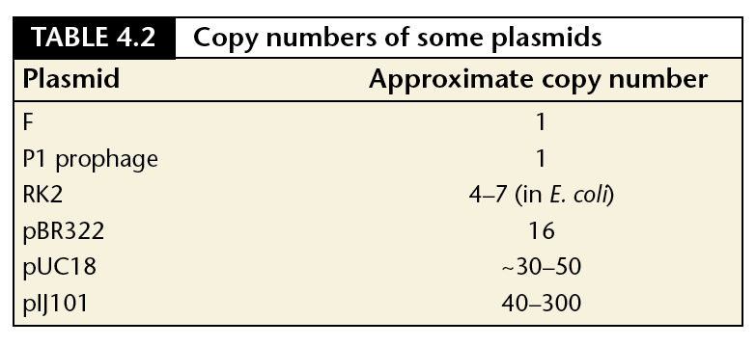
Size and copy number

Slide 7
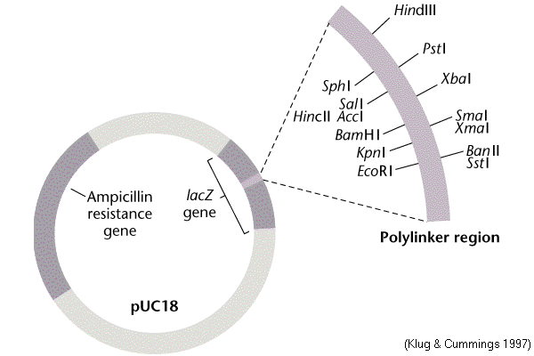
PLASMID VECTORS
Plasmid vectors are used to clone DNA ranging in size from several base pairs to several thousands of base pairs (100bp -10kb).
Features of many modern Plasmids
Small size
Origin of replication
Multiple cloning site (MCS)
Selectable marker genes
Some are expression vectors and have sequences that allow RNA polymerase to transcribe genes
DNA sequencing primers

Slide 8
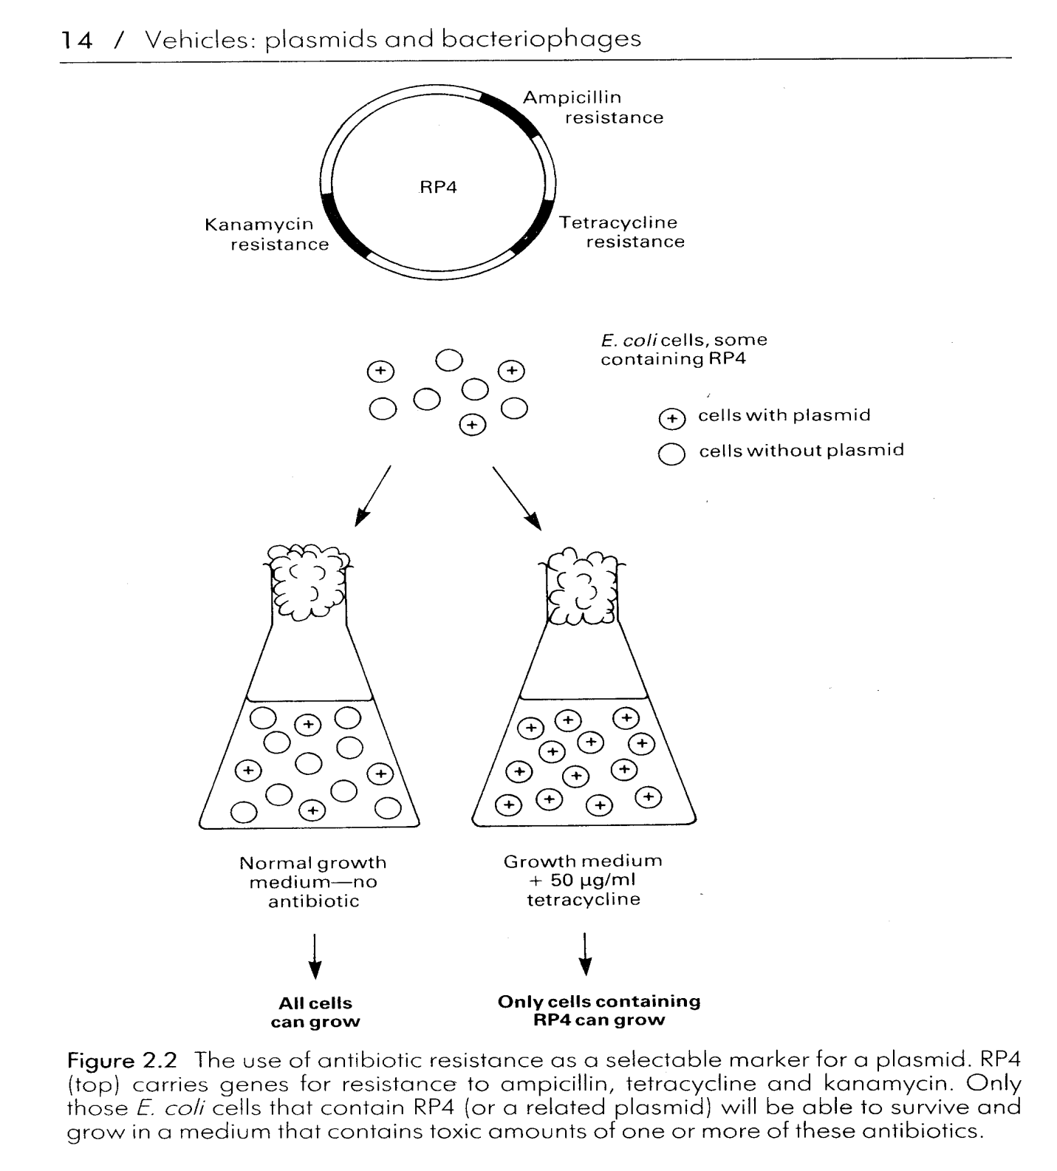
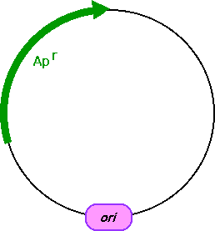
SELECTIVE MARKER

Slide 9
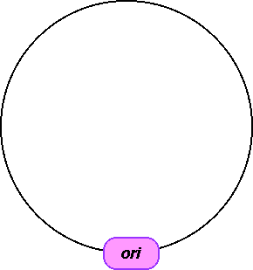
ORIGIN OF REPLICATION
Origin of replication is a DNA segment recognized by the cellular DNA-replication enzymes.
Without replication origin, DNA cannot be replicated in the cell.

Slide 10
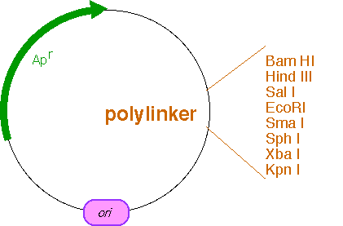
MULTIPLE CLONING SITE
Many cloning vectors contain a multiple cloning site or polylinker: a DNA segment with several unique sites for restriction endo- nucleases located next to each other
Restriction sites of the polylinker are not present anywhere else in the plasmid.
Cutting plasmids with one of the restriction enzymes that recognize a site in the polylinker does not disrupt any of the essential features of the vector

Slide 11
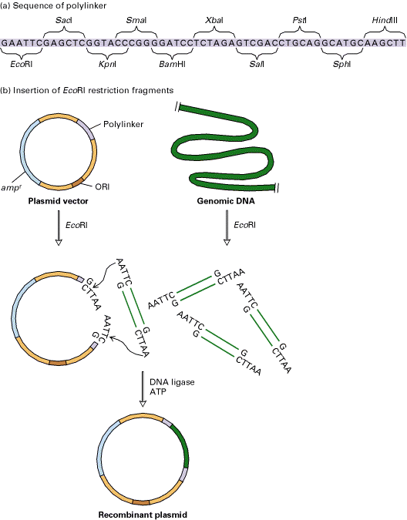
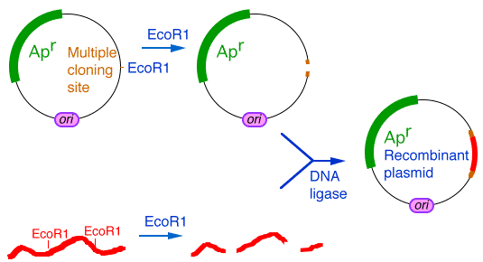
MULTIPLE CLONING SITE
Gene to be cloned can be introduced into the cloning vector at one of the restriction sites present in the polylinker

Slide 12
Practical Features of DNA Cloning Vectors (Plasmids)
origin of replication (ori)
multiple cloning sites (MCS) or restriction sites
selectable markers
RNA polymerase promoter sequences
Allows bacteria with this plasmid to grow in presence of ampicillin antibiotic
ori
amp^{R}
lacZ gene
MCS
If plasmid picks up a foreign piece of DNA at the MCS, then the lacZ gene is non-functional

Slide 13
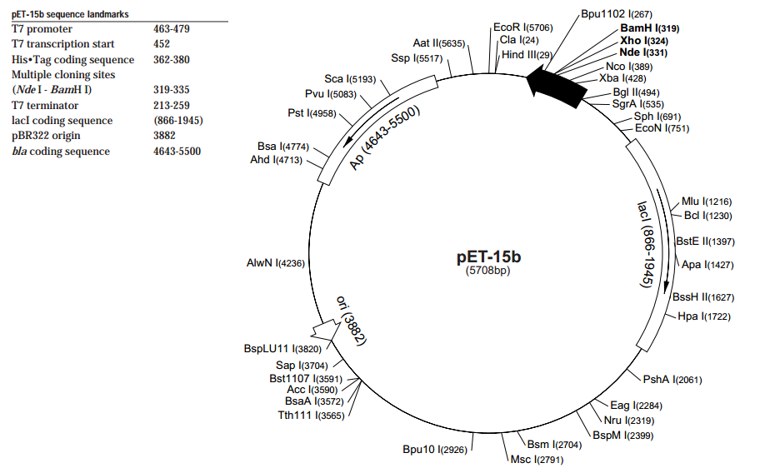

Slide 14
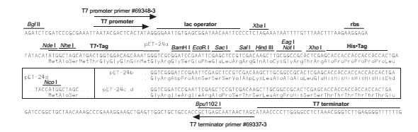

Slide 15
Plasmid Isolation from Bacteria
تنميه المزرعة البكتيرية المحتوية على البلازميد على بيئة سائلة
جمع الخلايا منها بالطرد المرطزى
تحضير المستخلص الخلوى من هذة الخلايا (Cell extract)
ويتم التخلص من البروتينات وازالة ال RNA.
بالاضافة الى ذلك يجب فصل DNA البلازميد عن الكميات الكبيرة من DNA الكرموسومات البكتيرية الموجودة ايضا فى الخلايا.

Slide 16
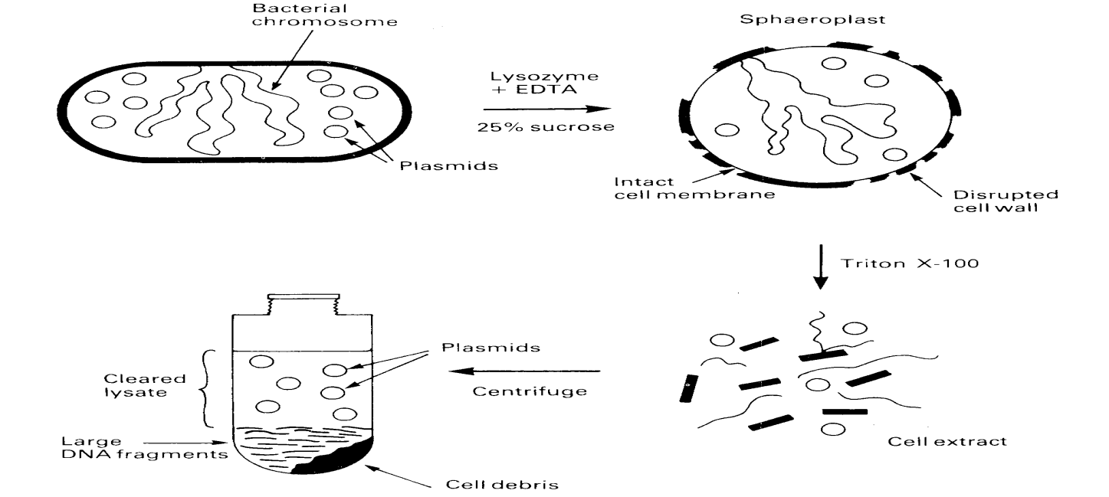
Plasmid DNA isolation
- فصل DNA البلازميدات بناء على الحجم:

Slide 17
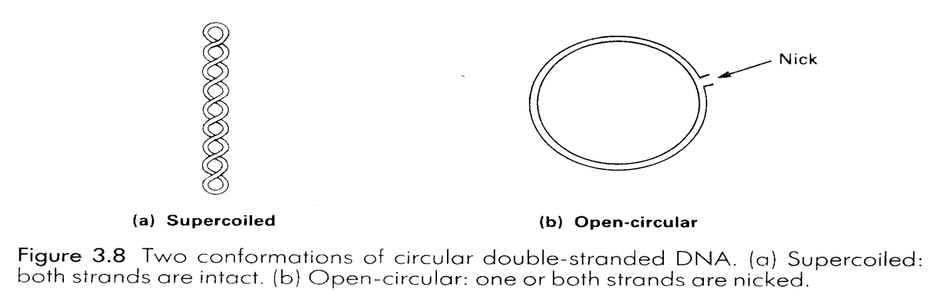
2- فصل DNA البلازميدات بناء على الشكل:
Alkaline denaturation
استخدام الطرد المركزي في وجود الايثيديوم بروميد والسيزيوم كلوريد.
Conformations of Plasmid DNAs

Slide 18
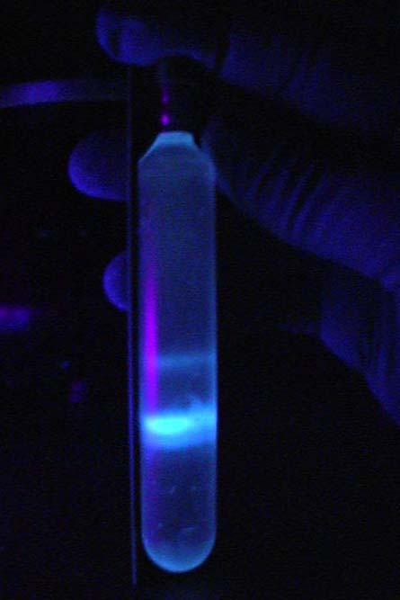
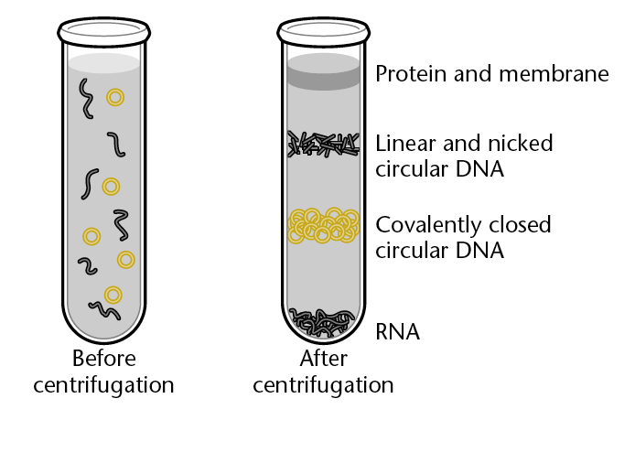
“Old School method of purifying plasmid”
After 10 hrs centrifugation at 100,000 rpm (450,000 xg), two distinct bands, corresponding to linear nuclear DNA above and circular DNA below, are visible under ultraviolet light.
CsCl gradient with ethidium bromide and UV light.

Slide 19
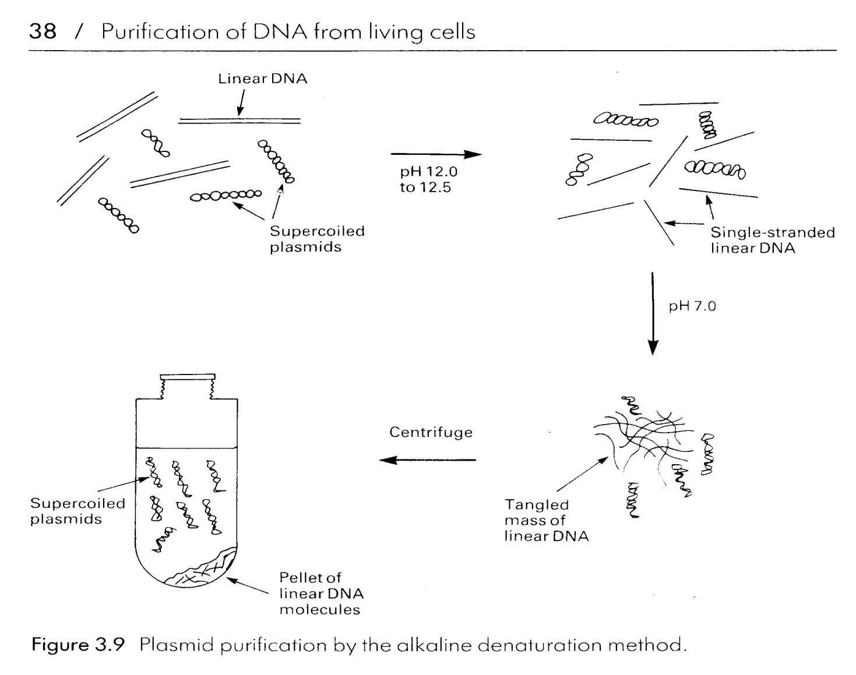
Alkaline denaturation

Slide 20
OTHER TYPES OF CLONING VECTORS

Slide 21
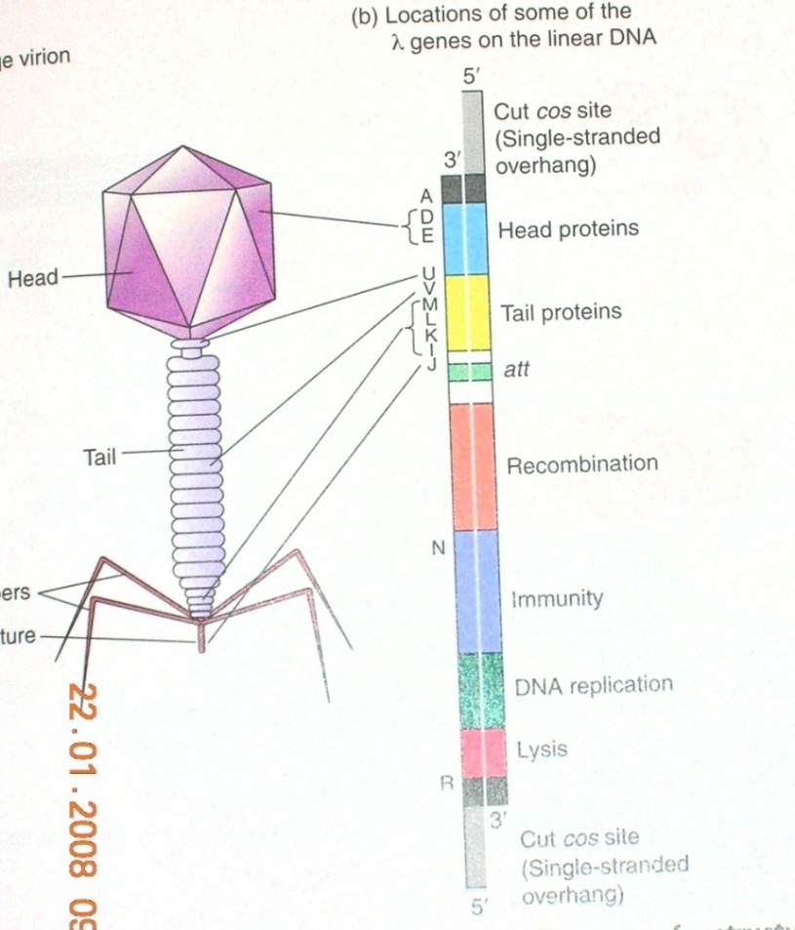
BACTERIOPHAGE LAMBDA
Phage lambda is a bacteriophage or phage, i.e. bacterial virus, that uses E. coli as host.
Its structure is that of a typical phage: head, tail, tail fibres.
Lambda viral genome: 48.5 kb linear DNA with a 12 base ssDNA "sticky end" at both ends; these ends are complementary in sequence and can hybridize to each other (this is the cos site: cohesive ends).
Infection: lambda tail fibres adsorb to a cell surface receptor, the tail contracts, and the DNA is injected.
The DNA circularizes at the cos site, and lambda begins its life cycle in the E. coli host.

Slide 22
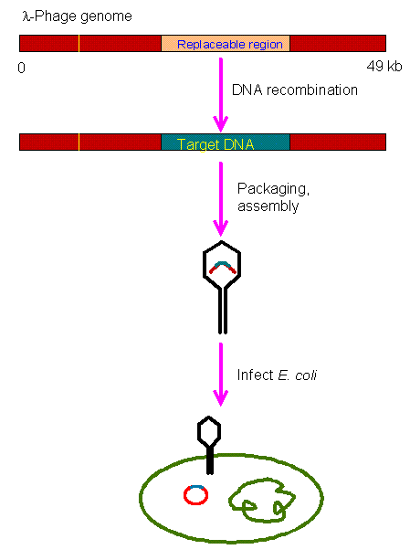

BACTERIOPHAGE LAMBDA

Slide 23
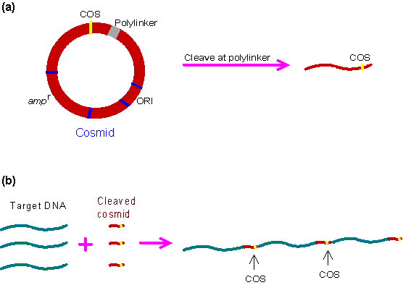
COSMID VECTOR
The cosmid vector is a combination of the plasmid vector and the COS site which allows the target DNA to be inserted into the λ head. It has the following advantages:
  High transformation efficiency.
  The cosmid vector can carry up to 45 kb whereas plasmid and λ phage vectors are limited to 25 kb.

Slide 24
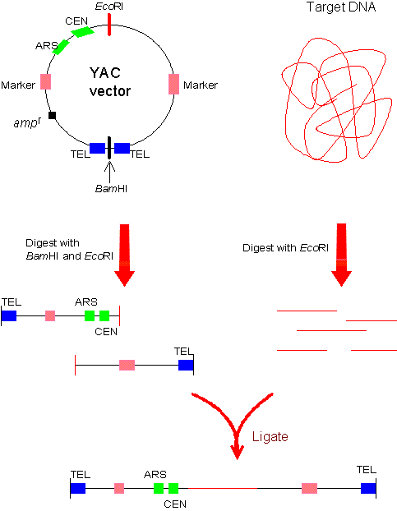
Yeast Artificial Chromosomes
The yeast artificial chromosome (YAC) vector is capable of carrying a large DNA fragment (up to 200 Kb), but its transformation efficiency is very low.

Slide 25


